Slide 1

Race to the Finish
Workers’ Compensation Bills Pending at the 85th Legislature
Speaker:
Bobby Stokes

Slide 2
Important Dates
January 10, 2017: Session Began
May 29, 2017: Session Ends
August 28, 2017: Most Passed Bills Take Effect

Slide 3
A Word of Warning . . .
What follows is not yet law, and may never be law.
A bill must pass the House and the Senate and not be vetoed by the Governor before it can take effect.
Most bills that are filed never become law.
Most of the bills in this presentation will never become law.

Slide 4
Categories this Session
And they’re off . . .
(some of these bills are nags)
Jockeying for position . . .
(where the race is won or lost)
Headed for home . . .
(these look like the easy winners)

Slide 5
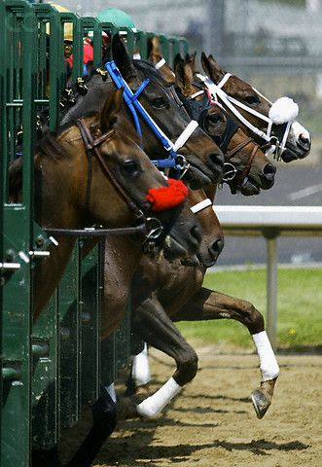
And they’re off . . .

Slide 6
And They’re off . . .
Bring Back Bad Faith
HB 499
This bill would partially reverse the Ruttiger decision and establish liability in court for unfair settlement practices with respect to WC Insurance claims.
Mandatory Comp
HB 1477
This bill would require the purchase of workers’ compensation insurance coverage for building and construction contractors and sub-contractors.

Slide 7
And They’re off . . .
Utilization Review
HB 2345
Relating to the performance and appeal of utilization review by and under the direction of physicians.

Slide 8
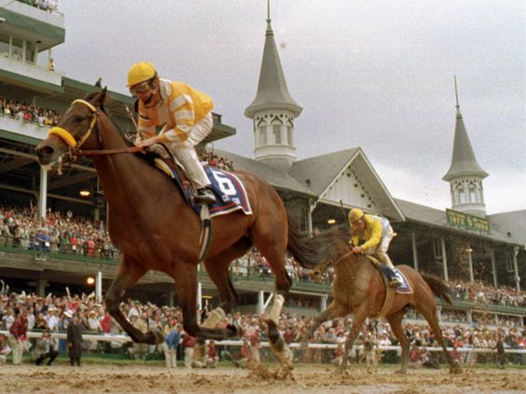
Jockeying for position
The race is on . . .
Bills race to get out of committee and across the capitol to pass both chambers . . .
At the end of the course the Governor waits with his pen . . .

Slide 9
Jockeying for position
UR for Work Hardening/Work Conditioning
HB 2058
Work hardening and work conditioning must be preauthorized unless facility meets an exemption established by DWC rule.
Compounding
HB 2830
DWC may, by rule, exclude compounded medications from the closed formulary.

Slide 10
Jockeying for position
Medical Evidence
HB 2546
Relating to the submission of reports by a physician assistant under the workers’ compensation system.
Attorney-Client Privilege
HB 1678
Provides that communications between representatives of insurers and policyholders that have a self-insured retention are protected from disclosure (privileged).

Slide 11
Jockeying for position
Subrogation Attorneys’ Fees/ Political Subdivisions
HB 2057
Political subdivisions who pursue subrogation recovery waive governmental immunity for attorneys’ fees payable to the attorney that makes the recovery.
Enforcement of EDI Violations
HB 4039
Requires DWC to consider whether a violation negatively impacts the payment of benefits to an injured worker; DWC should refrain from assessing penalties solely for EDI violations where carrier made a good-faith effort to comply.

Slide 12
Jockeying for position
Enforcement against Political Subdivisions
HB 1689
Provides that a political subdivision that self-insures individually or collectively is liable for sanctions under Chapter 415 of the Labor Code.
Enforcement against Administrators of Certified Self-Insurers
HB 2287
No penalties against certified self-insurers unless it knew the administrator was engaging in the prohibited conduct; penalty belongs to the administrator.

Slide 13
Jockeying for position
First Responders
HB 2119
Regardless of the date of death, a surviving spouse is entitled to DBs even if they have remarried.
PTSD and First Responders
HB 1983
A first responder who suffers PTSD has a compensable injury if caused by events in the C&S of employment and work was a substantial contributing factor to the diagnosis.

Slide 14
Jockeying for position
COLAs for Death Benefits
HB 2054
Requires an annual COLA to apply to death benefits, adjusted to inflation.
Lifetime Death Benefits Regardless of Remarriage
HB 2055
Allows eligible spouses to continue to receive DBs even after remarriage.

Slide 15
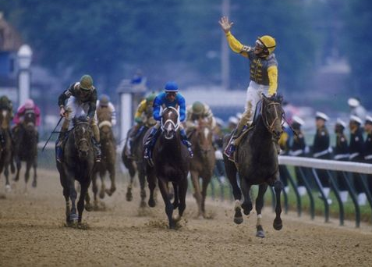
Headed for home . . .

Slide 16
Headed for home . . .
Single Point of Contact for First Responders
HB 1688; HB 2082
Requires OIEC to designate a liaison to assist law enforcement claimants.
URA Qualifications
HB 2345
URA physicians must be licensed in Texas.

Slide 17
Headed for home . . .
Enforcement Reorganization
HB 2053
Increases the authority of the Division to enforce the Act, with particular emphasis on Chapter 418 violations.
Enforcement Bonds
HB 1456
Eliminates the payment or bond requirement when appealing an enforcement penalty to SOAH.

Slide 18
Headed for home . . .
Judicial Review Notice and Procedure
HB 2061
Petitions in suits for judicial review must be filed with DWC; Requires more disclosure of the terms of agreed judgments, default judgments and settlements.
Designated Doctor Contracts
HB 2056
Designated doctors may be required to disclose copies of their contracts with vendors to the Division upon request.

Slide 19
Headed for home . . .
Ombudsman Qualifications
HB 2060
Eliminates the requirement that people hired as Ombudsmen have prior experience in workers’ compensation.
Medical Causation Reports
HB 2326
Requires carriers to reimburse claimant’s doctors for the creation of a medical causation narrative.

Slide 20
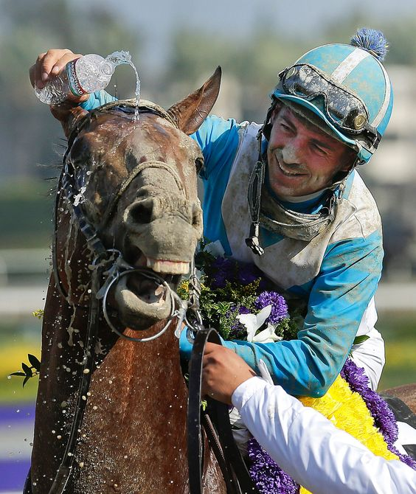
About the winners
Bills that have passed generally operate prospectively based on date of injury.
Highly popular bills take effect on Governor’s signature (usually in late May or early June).
Other bills will likely take effect August 28, 2017.

